Slide 1
SampleSuperStore (Retail Analysis)

Slide 2

Problem Statement
We find that we should calculate multiple things to take the right decision at the right time, we need to know the quantity of each category, count number of sales, the number of sales by segment, the profit, and the percentage of profit according to each region,…etc.
Many things needed to calculate to make predictions.

Slide 3

Scope
Get well-Structure data to process this data to make the right decision at the right time

Slide 4
Explanation of the dataset
Size: 365 KB
Rows: 6436 row
Columns: 13

Slide 5
Dax Operation
% Central = DIVIDE([Central],[Total Retails],0)
% Central = DIVIDE([Central],[Total Retails],0)
% East = DIVIDE([East],[Total Retails],0)
% South = DIVIDE([South],[Total Retails],0)
% West = DIVIDE([West],[Total Retails],0)
Central = CALCULATE([Total Retails],'SampleSuperstore'[Region]="Central")
East = CALCULATE([Total Retails],'SampleSuperstore'[Region]="East")
South = CALCULATE([Total Retails],'SampleSuperstore'[Region]="South")
West = CALCULATE([Total Retails],'SampleSuperstore'[Region]="West")
Total Retails = COUNTROWS('SampleSuperstore')

Slide 6
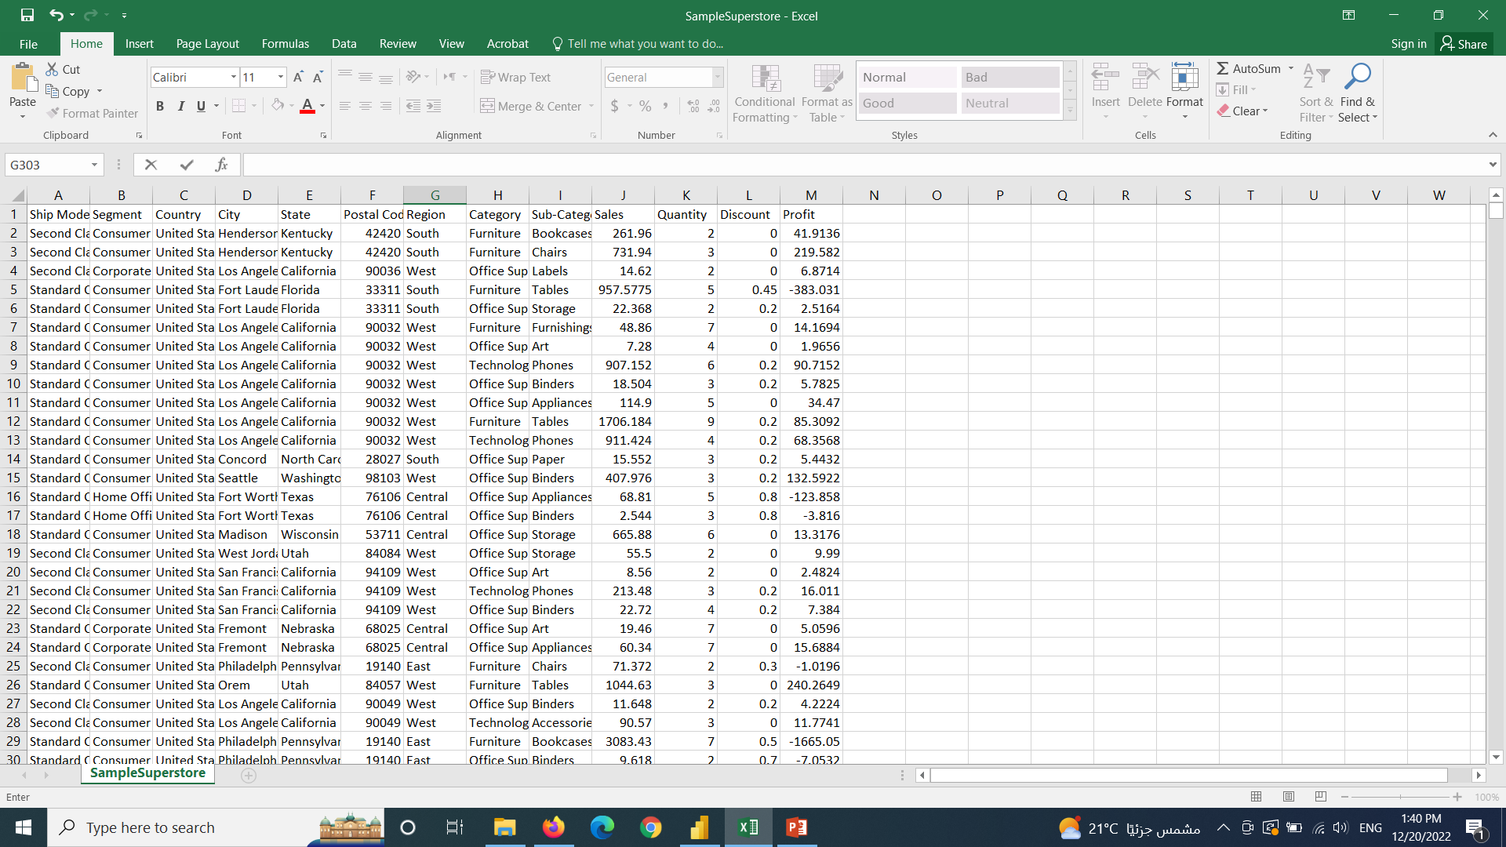
DataSet(SampleSuperStore,13 row)

Slide 7
Type Of Data
DATA NAME | DATA TYPE
Ship Mode | Qualitative
Segment | Qualitative
Country | Qualitative
City | Qualitative
State | Qualitative
Postal Code | Quantitative
Region | Qualitative
Category | Qualitative
Sub-Category | Qualitative
Sales | Quantitative
Quantity | Quantitative

Slide 8
Type Of Data
DATA NAME | DATA TYPE
Discount | Quantitative
Profit | Quantitative

Slide 9
Problems or reports:
What is the number of quantity of each category
What is the number of sales by segments
The count of number of sales
What is the sum of profit by each state
What is the most ship mode type chosen according to discount
What is the most ship mode type chosen according to the quantity and category
The percentage of each region in USA
What is percentage of the profit according to each region
What is percentage of the quantity according to each region

Slide 10
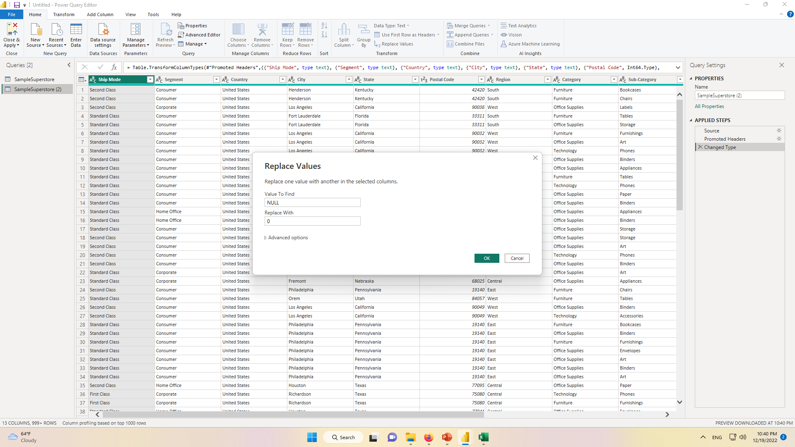
Edit queries (Replace NULL with 0)

Slide 11
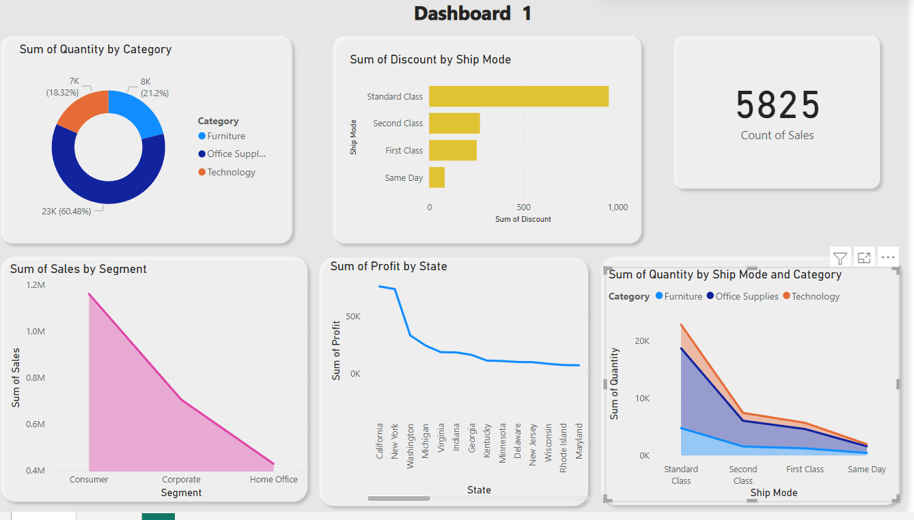

Slide 12
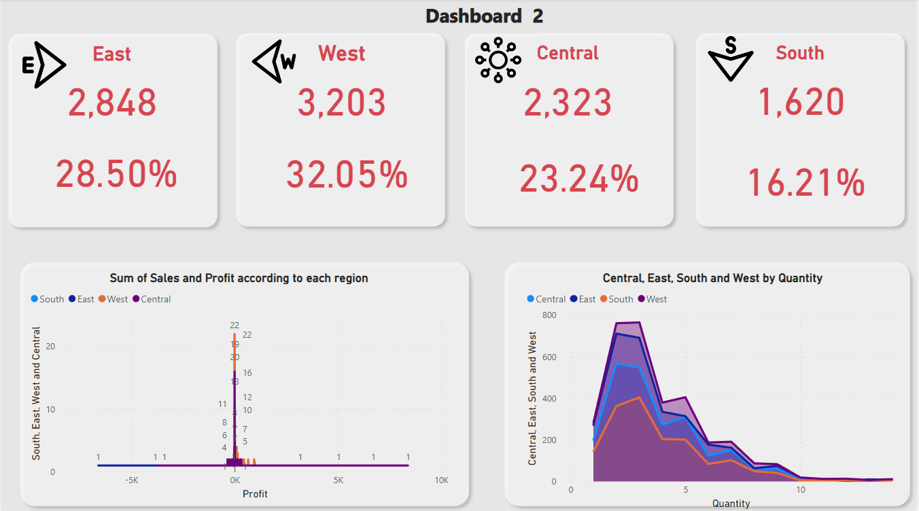

Slide 13

Thank you

